Slide 1
REG Procedure

Slide 2
REG Procedure
When do we need a REG procedure?
When we need to analyze the data for linear regression.
Note: The REG procedure is one of many regression procedures in SAS. REG is a general purpose procedure for regression, while other SAS regression procedures, such as CALIS, CATMOD, GLM, LIFEREG, LOGISTIC, NLIN, ORTHOREG, PROBIT, RSQUARE, RSREG, STEPWISE, SYSREG, TRANSREG, IML, AUTOREG, PDLREG, SYSLIN, or MODEL, have more specialized applications.

Slide 3
REG Procedure
What does the REG procedure do?
Produce the Least Squares estimates under classical statistical assumption.
Produce estimate regression model by using eight different model-selection methods (forward-selection algorithm, backward-elimination algorithm, stepwise-regression algorithm, maximum R-square improvement algorithm, minimum R-square improvement algorithm, highest R-square algorithm, highest adjusted R-square algorithm, and lowest C_{p} algorithm).
Produce the tests of linear hypotheses and multivariate hypotheses.

Slide 4
REG Procedure
Produce collinearity diagnostics.
Produce predicted values, residuals, studentized residuals, confidence intervals, and influence statistics.
Create several new SAS data sets containing calculated statistics.
Produce several plots.

Slide 5
REG Procedure
Which statements are included in a REG procedure?
FORMAT:
<1>
<2>
<3>
<4>
<5>
<6>
<7>
<8>
<9>
<10>
<11>
<12>
PROC REG options;
MODEL dependent variables = independent variables / options;
BY variable names;
ID variable name;
VAR variable name;
WEIGHT variable name;
FREQ variable name;
OUTPUT OUT = dsn keyword = variable names...; RESTRICT linear equation, .....;
TEST linear equation, ..../ options;
MTEST linear equation, ..../ options;
PLOT y-variable * x-variable = symbol ..../ options;

Slide 6
REG Procedure
Note: The PROC REG statement is always accompanied by
one or more MODEL statements. One OUTPUT
statement may follow each MODEL statement. Several
PLOT, RESTRICT, TEST, and MTEST statements
may follow each MODEL statement. WEIGHT and
FREQ statements are optionally specified once for the entire procedure.

Slide 7
REG Procedure
SPECIFICATIONS:
<1>
PROC REG options;
The REG procedure begins with a PROC REG statement. Any option specified in the PROC REG statement will apply to all the MODEL statements. The options that may appear in the statement are:
ALL
Requests the display of many different calculated statistics.
ALPHA=value
Set the significance level used for the construction of confidence intervals. The value must be between 0 and 1 and the default value is 0.05.

Slide 8
REG Procedure
CORR
Requests the display of the correlation matrix for all variables listed in the MODEL or VAR statement.
COVOUT
Requests the covariance matrices to be output to the OUTEST data set. The option is valid only if the option OUTEST =dsn is also specified.
DATA =dsn
Gives the name of the SAS data set to be used in the procedure. If it is omitted, the last SAS data set created will be used.

Slide 9
REG Procedure
EDF
Requests the number of regressors in the model excluding and including the intercept, the error degrees of freedom, and the model R square to be output to the OUTEST data set.
NOPRINT
Requests SAS does not to display the results.
OUTEST =dsn
Creates a new SAS data set containing parameter estimates and optional model fit summary statistics.

Slide 10
REG Procedure
OUTSSCP = dsn
Creates a new SAS data set containing corrected sums of squares and cross-products matrix for all variables used in the procedure.
SIMPLE
Requests the display of the simple descriptive statistics for each variable used in the procedure.
USSCP
Requests the display of the uncorrected sums of squares and cross-products matrix for all variables used in the procedure.

Slide 11
REG Procedure
SPECIFICATIONS:
<2>
MODEL dependent variables = independent variables
/ options;
The MODEL statement specifies the regression model. After the keyword MODEL, the dependent (response) variables are specified, followed by an equal sign and the list of independent variables (regressors) . If any options are used, they follow a slash in the statement. A slash is not needed if no options are specified. The options that may appear in the statement are:
ADJRSQ
Requests the computations of R square adjusted for degrees of freedom for each model selected.

Slide 12
REG Procedure
ALL
Requests all the futures of these options: CLI, CLM, CORRB, COVB, CP, P, R, SEQB, SS1, SS2, STB, TOL, and XPX.
B
Requests to compute the estimated regression coefficients of each model selected. The options is used with the options SELECTION=RSQUARE, SELECTION=ADJRSQ,
or
SELECTION=CP.

Slide 13
REG Procedure
BEST=n
IF SELECTION=ADJRSQ or SELECTION=CP is specified, BEST= option specifies the maximum number of subset models to be displayed or output to the OUTEST= data set.
IF SELECTION=RSQUARE is specified, BEST= option requests the maximum number of subset models for each size.
CLI
Requests the display of the 100(1-α)% prediction intervals for each predicted value.
Note: We may specify value of α in the PROC REG statement. The default value of α is 0.05.

Slide 14
REG Procedure
CLM
Requests the display of the 100(1-α)% confidence intervals for the expected value of the dependent variable for each observation.
COLLIN
Requests a detailed analysis of collinearity among the regressors. This includes eigenvalues, condition indices, and decomposition of the variances of the estimates with respect to each eigenvalue.

Slide 15
REG Procedure
COVB
Requests the display of the estimated covariance matrix of the estimates.
CORRB
Requests the display of the correlation matrix of the estimates.
CP
Requests the output of Mallows’ C_{p} statistic for each model selected to the OUTEST= data set.
INFLUENCE
Requests the display of the influence statistics.

Slide 16
REG Procedure
NOINT
Suppresses the intercept term that is included in the model automatically.
Model without NOINT option:
Model with NOINT option:
P
Requests the display of the actual values, the predicted values, and the residual.
R
Requests that the residuals to be analyzed.

Slide 17
REG Procedure
SELECTION = method
Specifies the method used to select the regression model. The selection method can be:
Option | Selection Method
ADJRSQ | Adjusted R-square selection
B | Backward elimination
CP | Mallow's C_{p} selection
F | Forward selection
MAXR | Maximum R-square improvement
MINR | Minimum R-square improvement
RSQUARE | R-square selection
STEPWISE | Stepwise selection/elimination

Slide 18
REG Procedure
SEQB
Requests the display of a sequence of parameter estimates as each variable is entered into the model.
SLE=value
Specifies the level of significance for entry into the model used in the FORWARD and STEPWISE methods. The defaults are 0.50 for FORWARD and 0.15 for STEPWISE.
SLS=value
Specifies the level of significance for staying in the model for the BACKWARD and STEPWISE methods. The defaults are 0.10 for BACKWARD and 0.15 for STEPWISE.

Slide 19
REG Procedure
SS1
Requests the display of the sequential sums of squares (Type I SS) along with the parameter estimates for each term in the model.
SS2
Requests the display of the partial sums of squares (Type II SS) along with the parameter estimates for each term in the model.
SSE
Requests the computation of the error sum of squares for each model selected.
STB
Requests the display of the standardized regression coefficients.

Slide 20
REG Procedure
TOL
Requests the display of the tolerance values for estimates.
XPX
Requests the display of the cross-products matrix for the model.

Slide 21
REG Procedure
SPECIFICATIONS:
<3>
BY variable names;
The BY statement may appear with REG procedure if separate regression for each of the BY groups are requested and the data set has been sorted in the order of the BY variables.

Slide 22
REG Procedure
SPECIFICATIONS:
<4>
ID variable name;
The ID statement names a variable to identify observations in the displays. ID statement may appear with each MODEL statement. When one of the MODEL statement options CLI, CLM, P, R, and INFLUENCE is requested, the variables listed in the ID statement are displayed beside each observation. These variables can be used to identify each observation. If the ID statement is omitted, the observation number is used to identify the observations.

Slide 23
REG Procedure
SPECIFICATIONS:
<5>
VAR variable name;
The VAR statement names the numeric variables for which crossproducts are to be computed, variables that can be interactively added to the model, or variables to be used in scatter plots.

Slide 24
REG Procedure
SPECIFICATIONS:
<6>
WEIGHT variable name;
The WEIGHT statement specifies the variable name whose values are used to calculate the weighted least squares estimates.

Slide 25
REG Procedure
SPECIFICATIONS:
<7>
FREQ variable name;
When a FREQ statement appears, each observation in the SAS data set is assumed to represent k observations in the calculation, where k is the value of the variable whose name is listed in the statement. If k is not an integer, then only the integer portion is used. If k is less than 1, then a value of zero is assumed.
Note: The WEIGHT and FREQ statements have a similar effect,
except in the calculation of degree of freedom.

Slide 26
REG Procedure
SPECIFICATIONS:
<8>
OUTPUT OUT = dsn keyword = variable names...;
The OUTPUT statement specifies an output data set to contain statistics calculated for each observation. The options that may appear in the statement are:
OUT=dsn
Gives the name of the new data set. By default, the procedure uses the DATAn convention to name the new data set.

Slide 27
REG Procedure
Keyword=names
Specifies the statistics to include in the output data set and names the new variables that contain the statistics. For each statistic, specify the keyword, an equal sign, and a variable name for the statistic on the output data set. The keywords are:

Slide 28
REG Procedure
Keyword | Description
COOKD | Cook’s D influence statistic
COVRATIO | standard influence of observation on covariance of betas
DFFITS | standard influence of observation on predicted value
H | leverage, x_{i}(X’X)⁻¹x_{i}’
LCL | lower bound of a 100(1-α)% prediction interval for an individual prediction
LCLM | lower bound of a 100(1-α)% confidence interval for the expected value (mean) of the dependent variable
P | predicted values
R | residuals
RSTUDENT | studentized residuals
STDI | standard error of the individual predicted value
STDP | standard error of the mean predicted value
STUDENT | studentized residuals
LCL | upper bound of a 100(1-α)% prediction interval for an individual prediction
LCLM | upper bound of a 100(1-α)% confidence interval for the expected value (mean) of the dependent variable

Slide 29
REG Procedure
SPECIFICATIONS:
<9>
RESTRICT linear equation, .....;
A RESTRICT statement is used to place restrictions on parameter estimates in the model preceding it. If more than one restriction appears, restrictions should be separated by commas and the restrictions must be consistent. For example, the following statements:
MODEL D = W X Y Z;
RESTRICT X+Y=0, W-2*Z+INTERCEPT=5;
indicate the statistical model for analysis is
D = β₀ +β₁*W + β₂*X + β₃*Y + β₄*Z + ε
with restrictions as:
β₂+β₃ = 0
and
β₁ −2*β₄ + β₀ =5

Slide 30
REG Procedure
SPECIFICATIONS:
<10>
TEST linear equation, ..../ options;
A TEST statement is used to test hypotheses about the parameters estimated in the MODEL preceding it. Each equation specifies a linear hypothesis to be tested, and the hypothesis equations are separated by commas. The REG procedure performs an F test for the joint hypotheses specified in a single TEST statement. More than one TEST statement can accompany a MODEL statement. The numerator is the usual quadratic form of the estimates; the denominator is the mean squared error. If hypotheses can be represented by

Slide 31
REG Procedure
then the numerator of the F test is
divided by degrees of freedom.
For example, the following statements:
MODEL D = W X Y Z;
TEST X=10,
W+Y=5,
3*INTERCEPT-W+2*Z=0;
indicate for the statistical model as
D = α +β₁*W + β₂*X + β₃*Y + β₄*Z + ε

Slide 32
REG Procedure
The following three testing hypotheses will be tested.
H_{o}: β₂ = 10 vs. H_{a}: β₂ ≠ 10
H_{o}: β₁ + β₃ = 5 vs. H_{a}: β₁ + β₃ ≠ 5
and
H_{o}: 3α−β₁ + 2β₄ = 0 vs. H_{a}: 3α−β₁ + 2β₄ ≠ 0

Slide 33
REG Procedure
Follows a slash (/), the only option can be specified in the TEST statement is:
PRINT
Requests the display of intermediate calculations.

Slide 34
REG Procedure
SPECIFICATIONS:
<11>
MTEST linear equation, ..../ options;
The MTEST statement is used to test hypotheses in multivariate regression models where there are several dependent variables fit to the same regressors. If no equations or options are specified, the MTEST statement tests the hypothesis that all estimated parameters except the intercept are zero. The hypotheses that can be tested with the MTEST statement are of the form:

Slide 35
REG Procedure
For example, the following statements:
MODEL Y1 Y2 Y3 = X1 X2 X3 X4;
MTEST Y1-Y2, Y2-Y3, X1;
indicate for testing the hypothesis that the X1 parameter is the same for all three dependent variables.

Slide 36
REG Procedure
SPECIFICATIONS:
<12>
PLOT y-variable * x-variable = symbol ..../ options;
The PLOT statement print scatter plots with y-variables on the vertical axes and x-variables on the horizontal axes. More than one plot can be specified in the PLOT statement. The y-variables or x-variables can be any variables that appear in the VAR statement or in MODEL statement or statistics available in the OUTPUT statement. For statistics use keyword. For example
PLOT RESIDUAL.*PREDICTED.= '*';
The symbol can be specified as a single character enclosed in quotes or the name of any variable in the data set.

Slide 37
REG Procedure
The following options can be used in the PLOT statement after a slash (/):
HPLOTS = n
Sets the number of scatter plots that can be printed across the page.
OVERLAY
Allows requested scatter plots to be superimposed.
SYMBOL = 'character'
Changes the default plotting symbol used for all scatter plots produced in the current and in subsequent PLOT statement.
VPLOTS = n
Sets the number of scatter plots that can be printed down the page.

Slide 38
REG Procedure
Example
LIBNAME T9 'C:\Data';
PROC REG DATA=T9.profit ;
MODEL SALE = COST ;
TITLE 'Fitting simple linear regression using SALE as response variable and COST as regressor';
RUN;

Slide 39
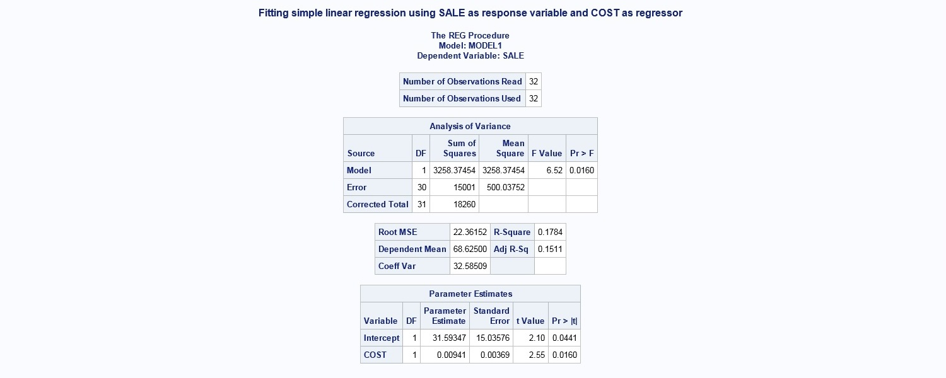
REG Procedure

Slide 40
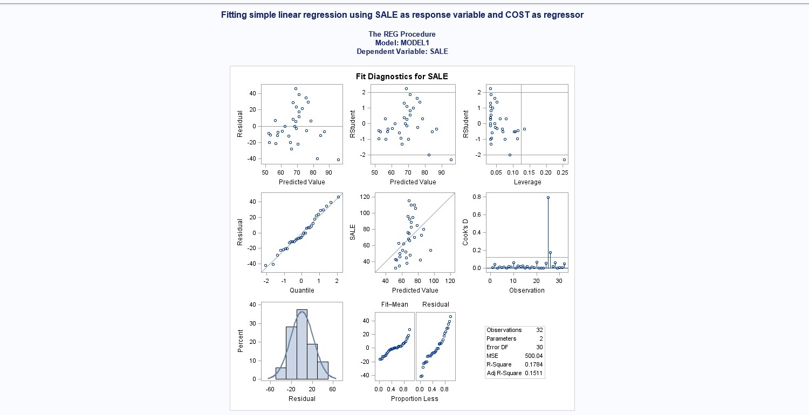
REG Procedure

Slide 41
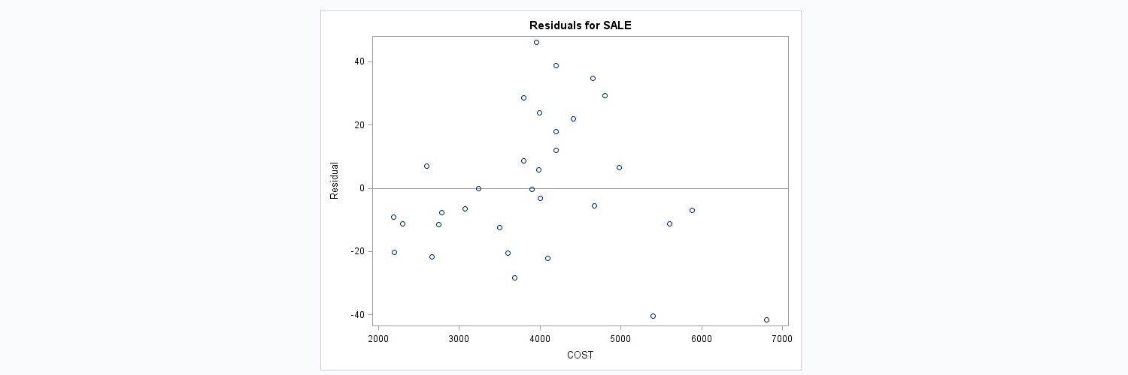
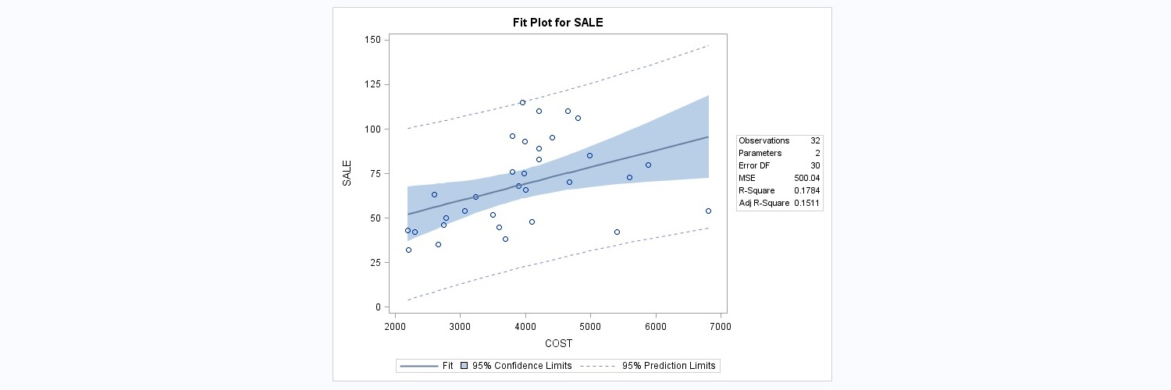
REG Procedure

Slide 42
REG Procedure
Example
LIBNAME T9 'C:\Users\csung1\Documents\My SAS Files\Csung\Data';
PROC REG DATA=T9.E92;
MODEL Y = X1 X2 X3 X4 X5 X6 X7 X8
/SELECTION=STEPWISE SLE=0.1 SLS=0.05;
PLOT Residual.*(X4 X5 X7 X8);
TITLE 'Example for REG Procedure';
RUN;

Slide 43
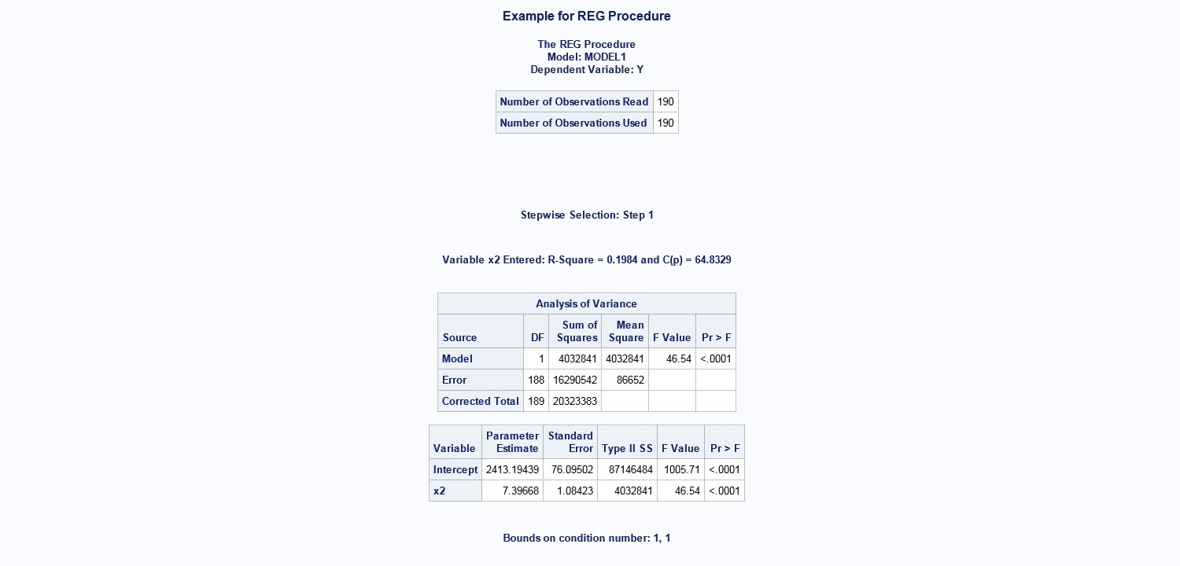
REG Procedure

Slide 44
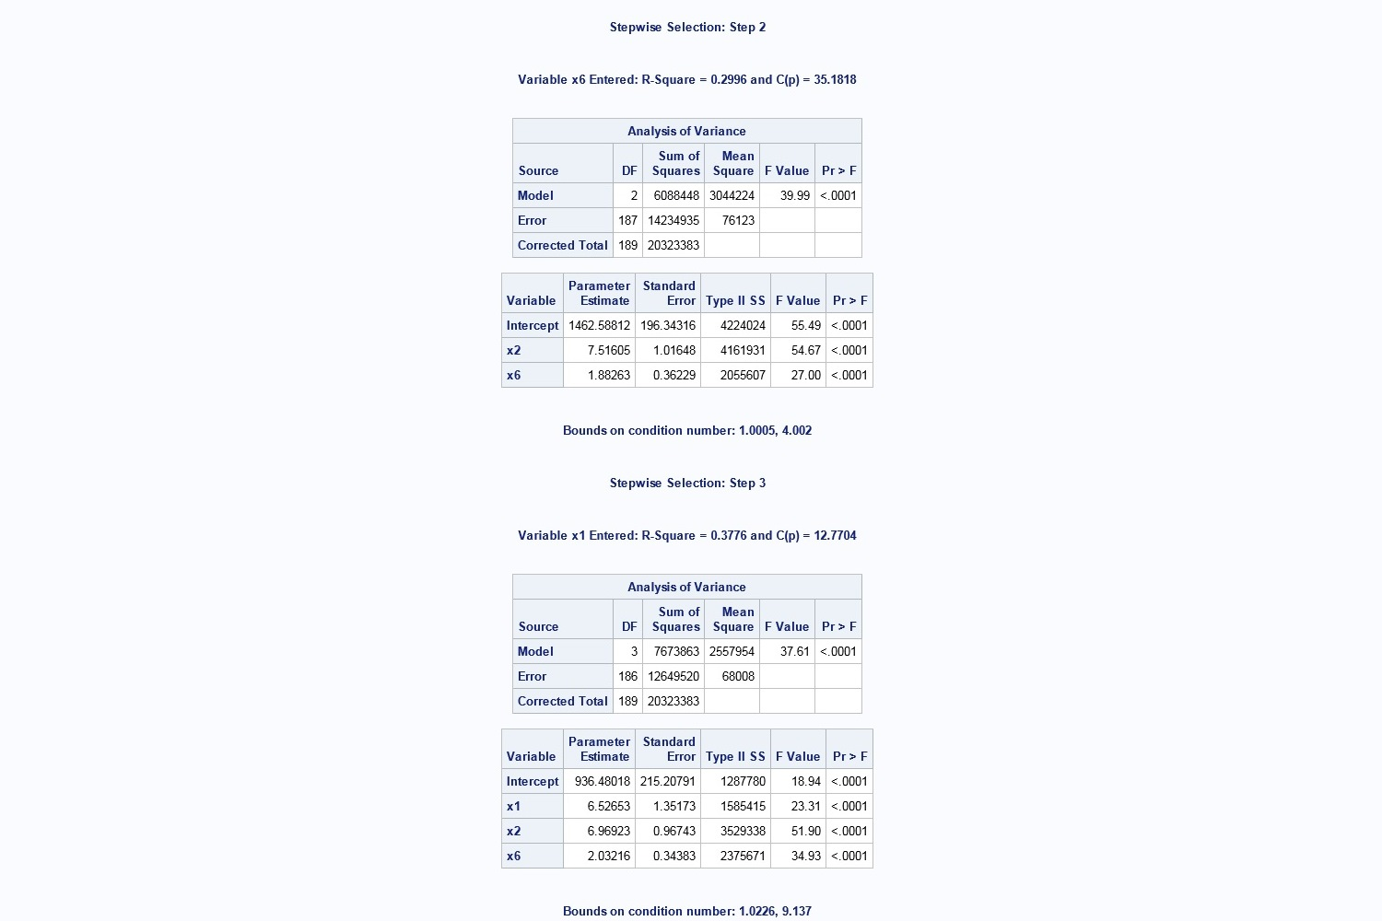
REG Procedure

Slide 45
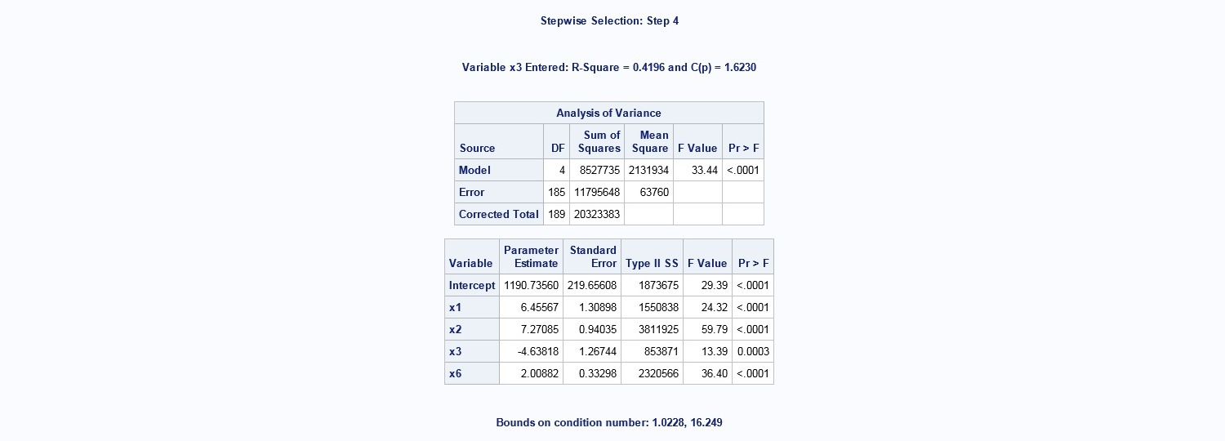
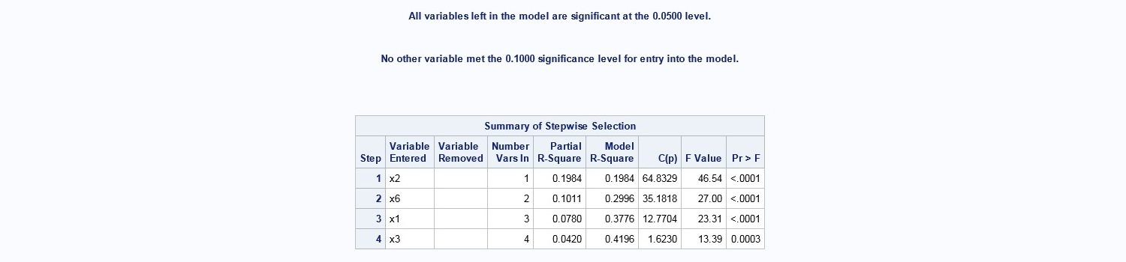
REG Procedure

Slide 46
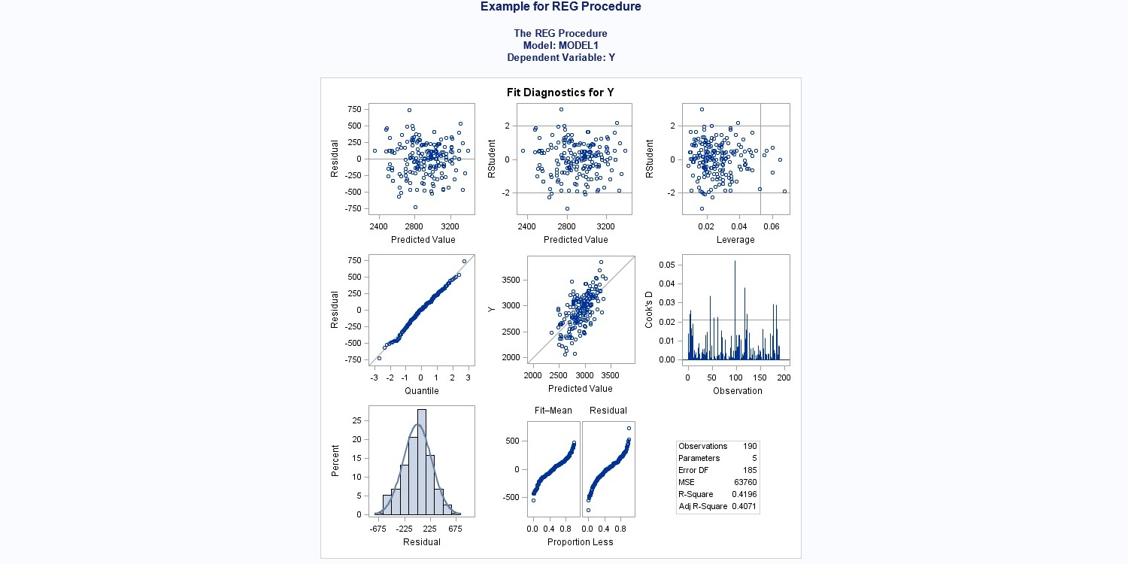
REG Procedure

Slide 47
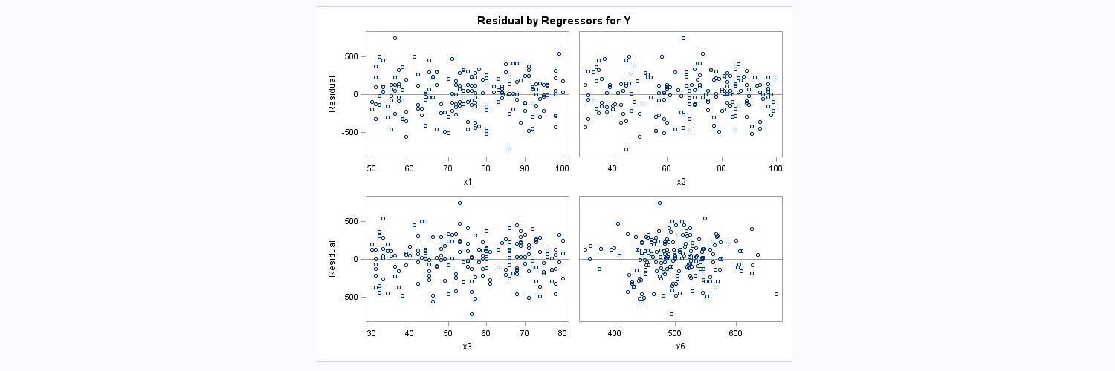
REG Procedure

Slide 48
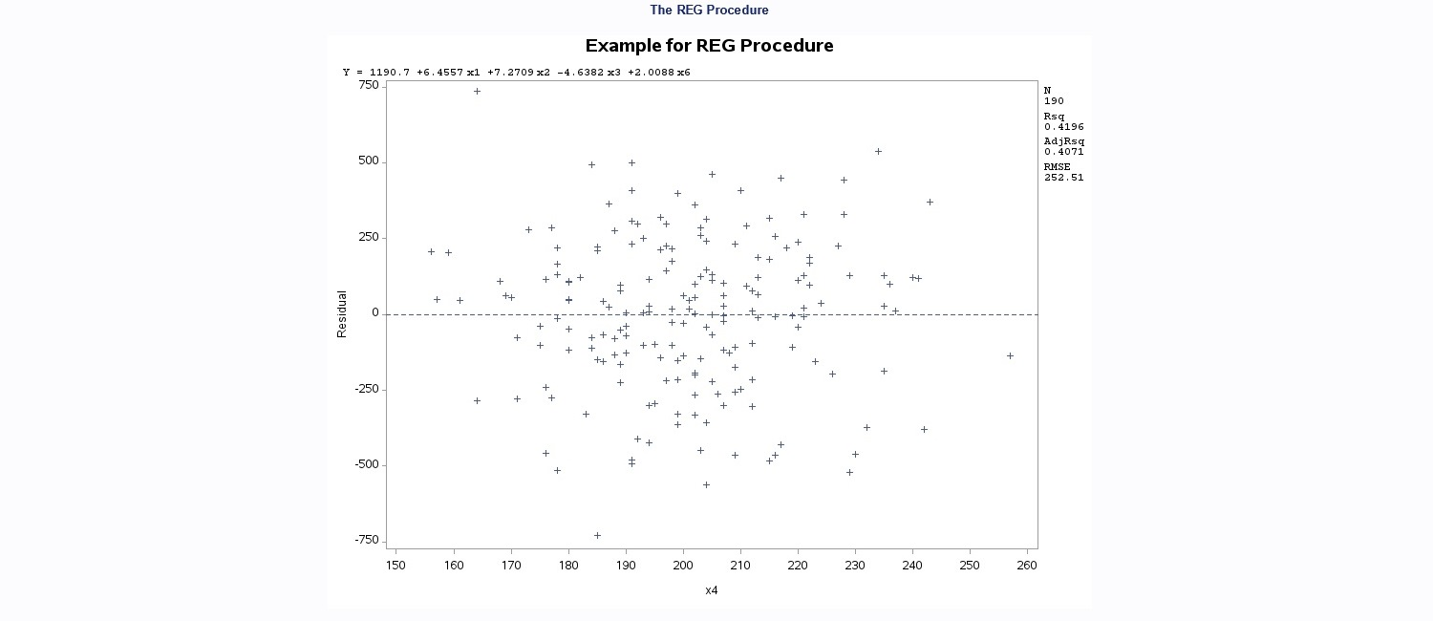
REG Procedure

Slide 49
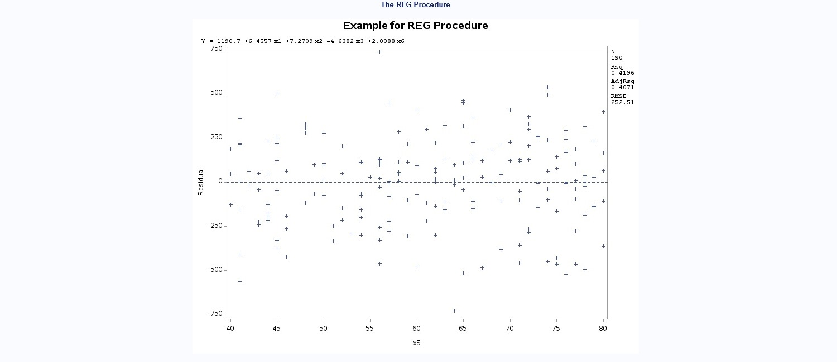
REG Procedure

Slide 50
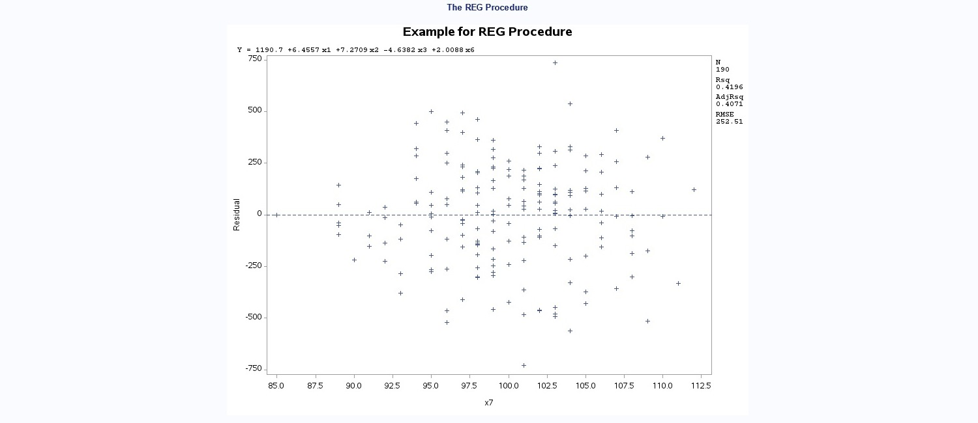
REG Procedure

Slide 51
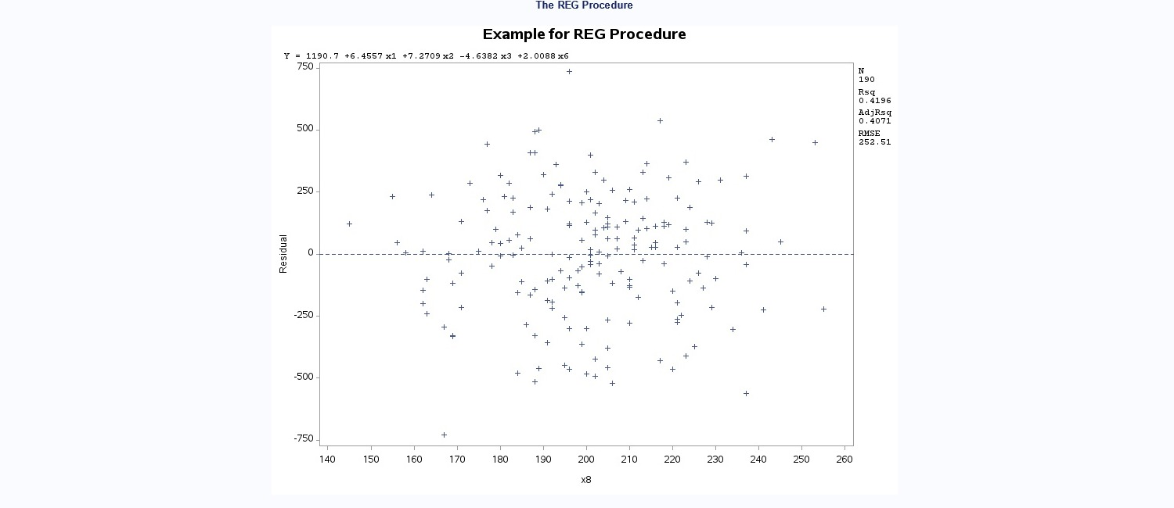
REG Procedure

Slide 52
REG Procedure
Example
FILENAME E93 'C:\Data\water.dat';
DATA A;
INFILE E93;
INPUT X Y ;
X2=X**2;X3=X**3;X4=X**4;X5=X**5;X6=X**0.1;
X7=X**0.5;X8=X**1.5;X9=X**2.5;
PROC REG DATA=A;
TITLE 'Example 09.3: Model Development --- Selection of Variables';
MODEL1:MODEL Y=X;
MODEL2:MODEL Y=X X2;
MODEL3:MODEL Y=X X2 X3 X4 X5 X6 X7 X8 X9
/SELECTION=B;
RUN;

Slide 53
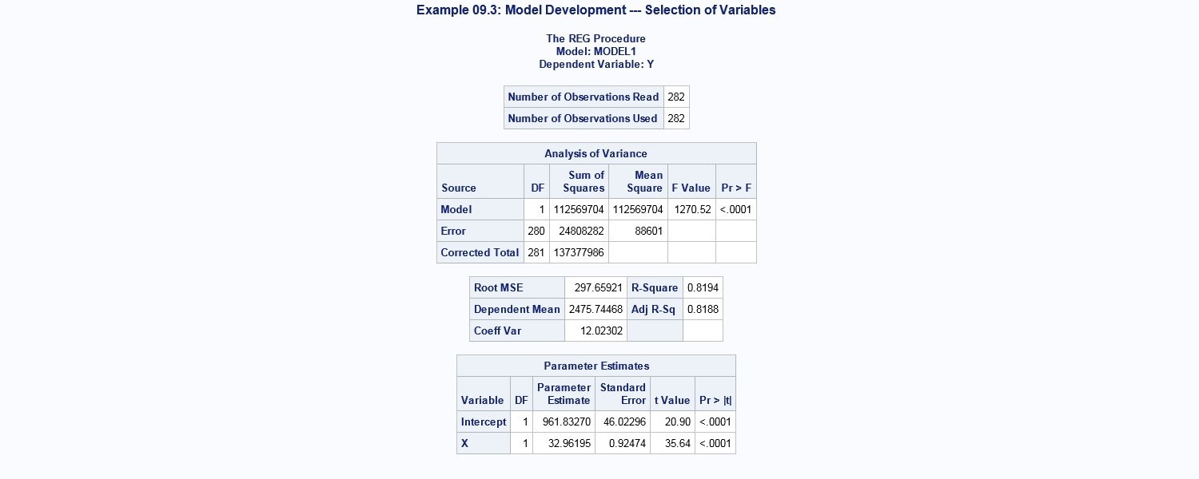
REG Procedure

Slide 54
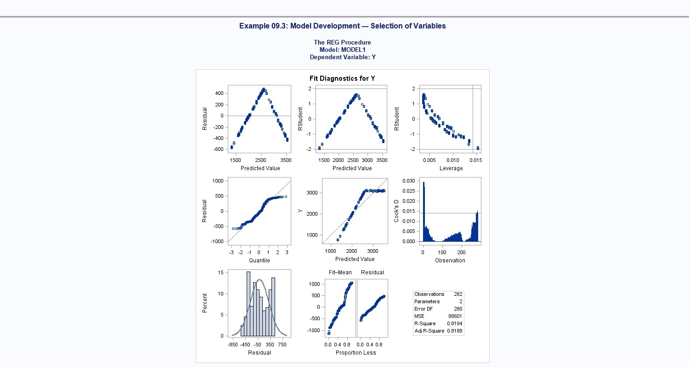
REG Procedure

Slide 55
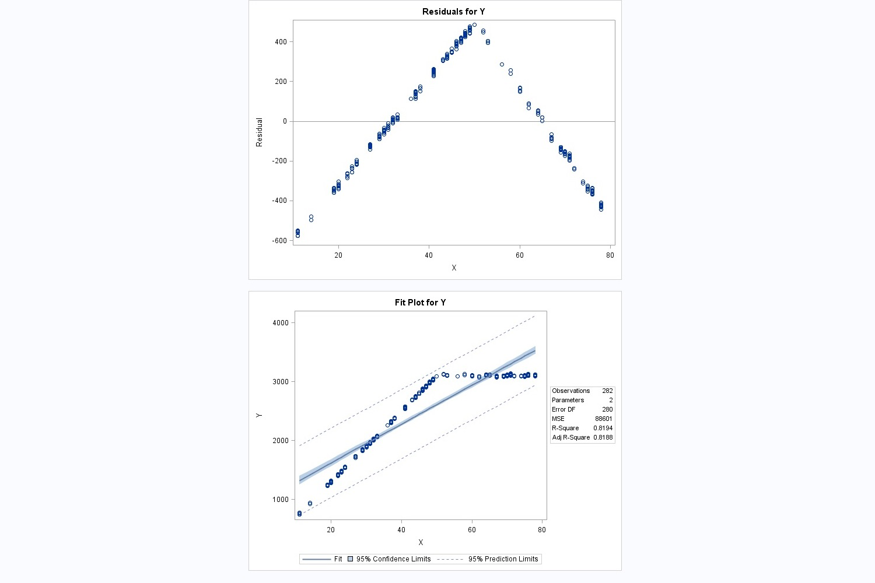
REG Procedure

Slide 56
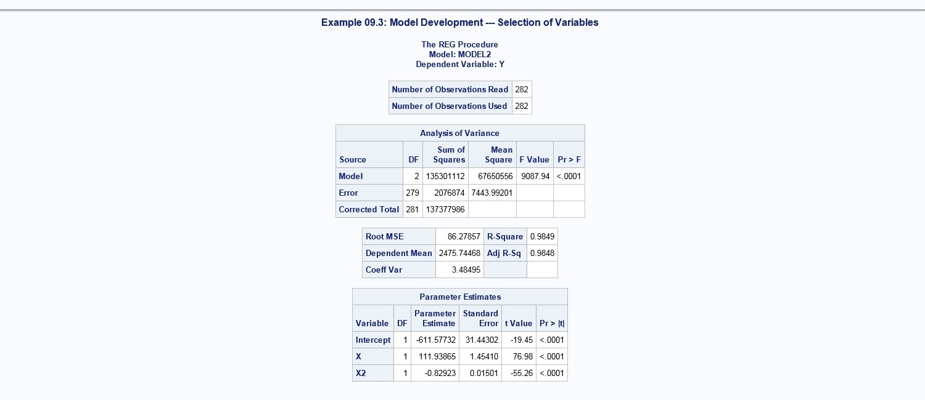
REG Procedure

Slide 57
REG Procedure

Slide 58
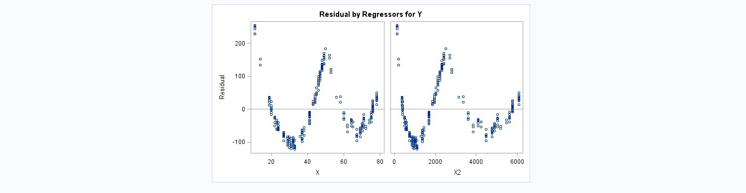
REG Procedure

Slide 59
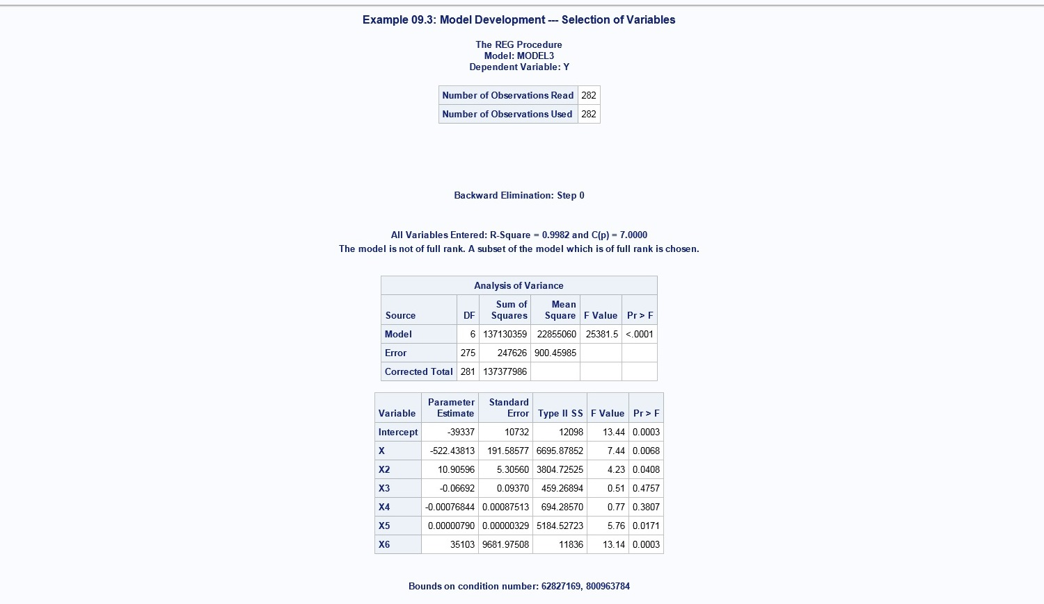
REG Procedure

Slide 60
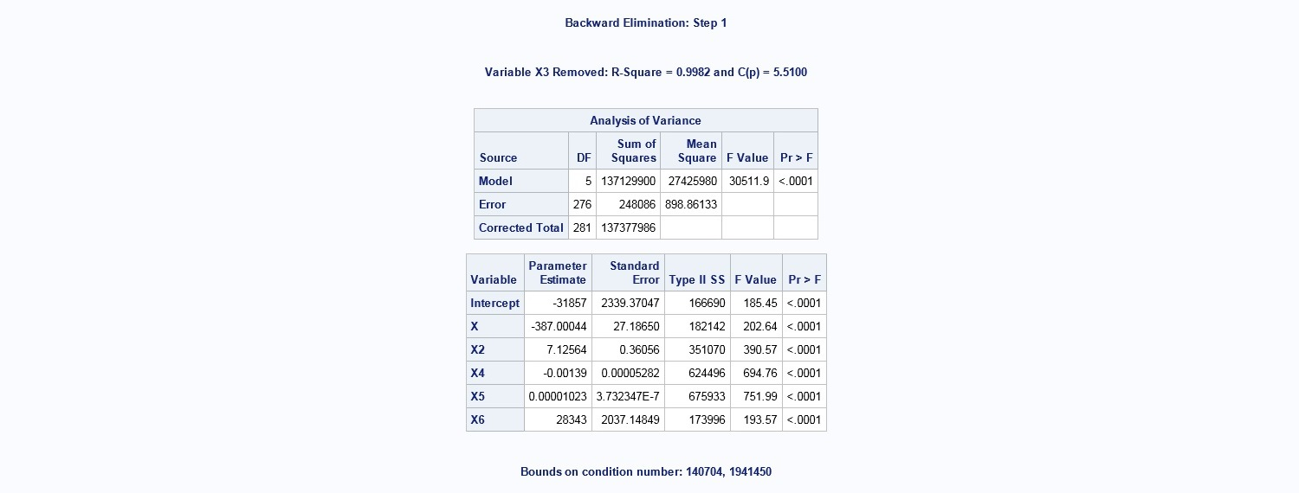
REG Procedure

Slide 61
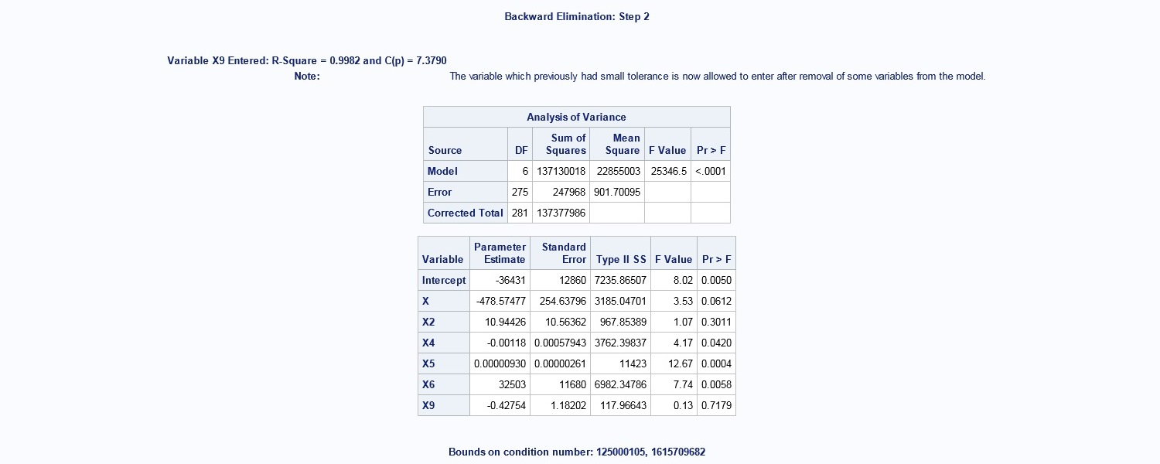
REG Procedure

Slide 62
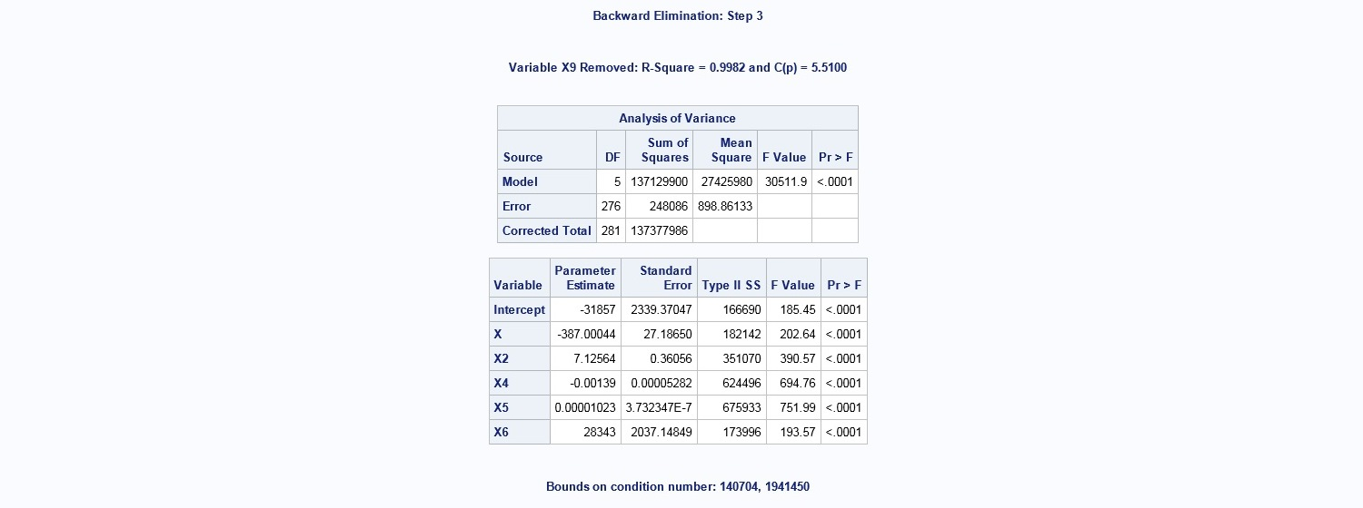
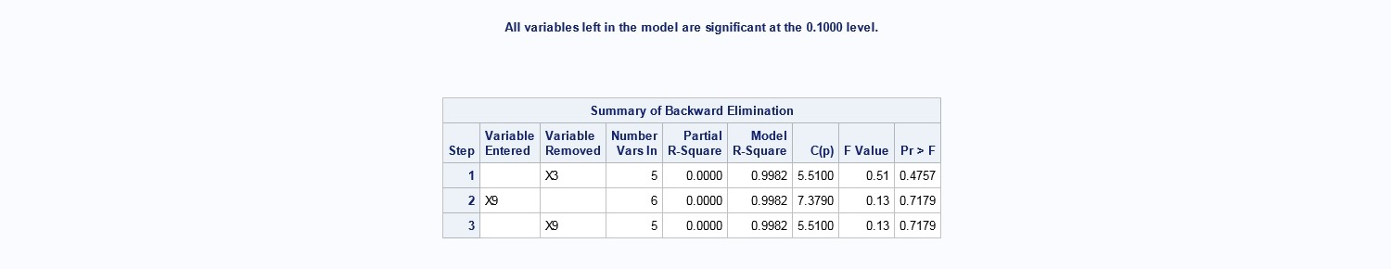
REG Procedure

Slide 63
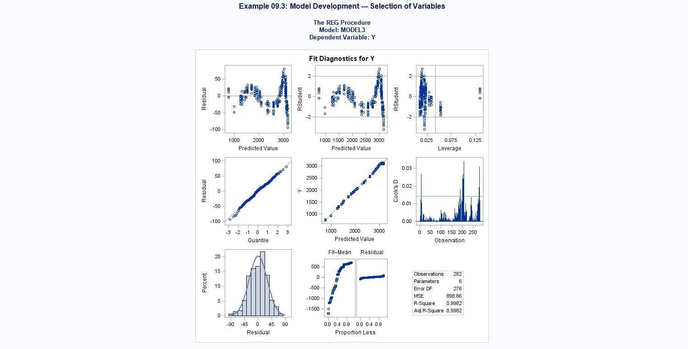
REG Procedure

Slide 64
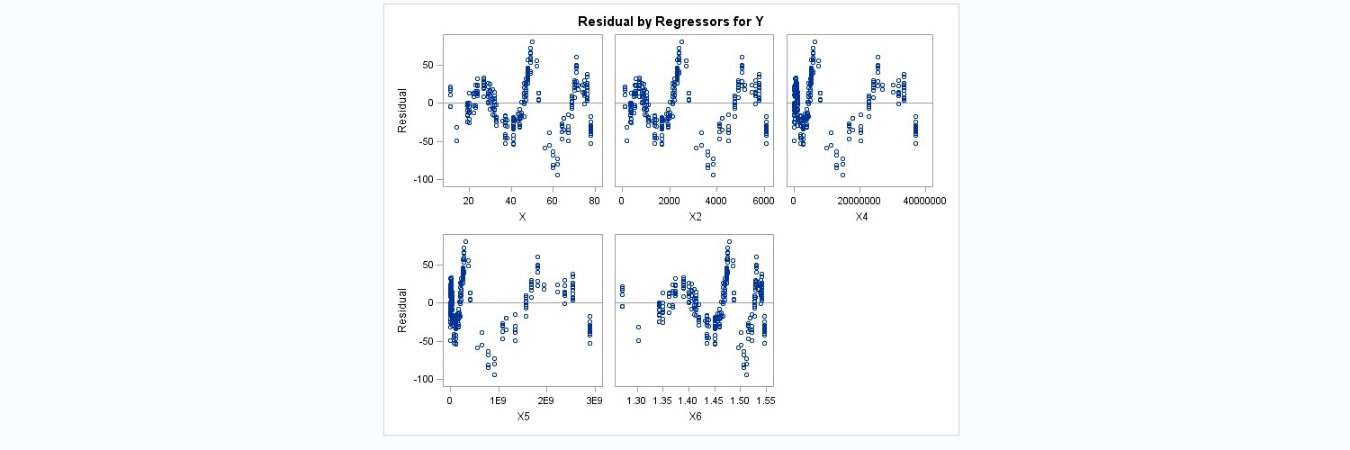
REG Procedure

